Slide 1

PROJECT ON MOBILE PRICE PREDICTION
NAME: S. SUJANA KUMARI AFFILIATION: DIGICROME ACADEMY

Slide 2
PROJECT OVERVIEW
Project Scenario:
To work for a prominent organization that specializes in selling mobile phones. The organization is keen to enhance its pricing strategy by gaining a deeper understanding of the key features that influence the prices of mobile phones in today's highly competitive market. Our objective is to build a predictive model that can accurately estimate the price of a mobile phone based on its features. To achieve this, we will perform a feature extraction analysis to identify the most influential features.
Project Description:
In this project, we will work with a dataset that contains detailed information about various mobile phones, including their model, color, memory, RAM, battery capacity, rear camera specifications, front camera specifications, presence of AI lens, mobile height, processor, and, most importantly, the price. Our primary goal is to develop a predictive model for mobile phone prices.

Slide 3
INTRODUCTION TO MOBILE PHONE PRICE PREDICTION
Accurate pricing is essential for manufacturers to optimize profitability, retailers to maximize revenue and differentiate themselves, and consumers to make informed purchasing decisions based on value and affordability. It plays a critical role in shaping market dynamics, fostering competition, and building sustainable relationships between businesses and consumers in the mobile phone industry.
Definition and importance of price prediction in the mobile phone industry: Price prediction in the mobile phone industry is crucial for making informed business decisions, optimizing revenue, gaining competitive advantage, and understanding consumer behavior. Utilizing advanced analytics and predictive models enables companies to navigate the complex landscape of pricing dynamics and achieve sustainable growth in a competitive market environment.
Significance of accurate pricing for manufacturers, retailers, and consumers: Accurate pricing is essential for manufacturers to optimize profitability, retailers to maximize revenue and differentiate themselves, and consumers to make informed purchasing decisions based on value and affordability. It plays a critical role in shaping market dynamics, fostering competition, and building sustainable relationships between businesses and consumers in the mobile phone industry.

Slide 4
DATA DESCRIPTION
SOURCE OF MOBILE DATA: The data used for the analysis is provided by Next Hikes.
FEATURES/VARIABLES INCLUDED: There are around 12 features and variables included in the data. The most common and important variables include Memory, Battery, RAM, Camera, Processor etc.
DATA SIZE AND FORMAT: The data has around 541 rows and 12 columns in the form of csv.
NECESSARY LIBRARIES TO BE IMPORTED:
import pandas as pd
import numpy as np
import matplotlib.pyplot as plt
import seaborn as sns
from sklearn.model_selection import train_test_split
from sklearn.ensemble import RandomForestRegressor
from xgboost import XGBRegressor
from sklearn.metrics import mean_absolute_error, mean_squared_error, r2_score

Slide 5
METHODOLOGY
Data Loading and Initial Exploration:
a. Importing the Dataset.
b. Displaying the First Few Rows of Data
c. Basic Summary Statistics (mean, median, min, max, etc.)
Data Cleaning and Preprocessing:
a. Handling Missing Values.
b. Removing Duplicates.
c. Checking for Data Integrity Issues.
Exploratory Data Analysis (EDA):
a. Univariate Analysis: Conduct a univariate analysis to understand the distribution of key variables like house prices. Utilize histograms, kernel density plots, or other visualizations to gain insights into the data.
b. Multivariate Analysis: Perform multivariate analysis to understand the correlations and dependencies between various features. Utilize techniques like correlation matrices or scatterplot matrices for a comprehensive view.

Slide 6
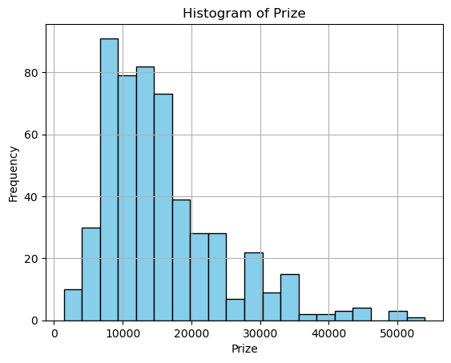
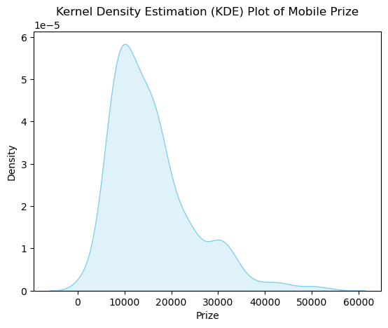
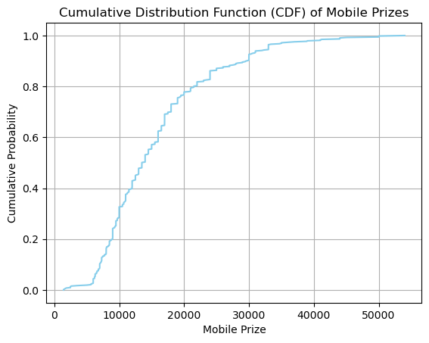
METHODOLOGY
Exploratory Data Analysis (EDA):
a. Univariate Analysis: Conduct a univariate analysis to understand the distribution of key variables like house prices. Utilize histograms, kernel density plots, or other visualizations to gain insights into the data.

Slide 7
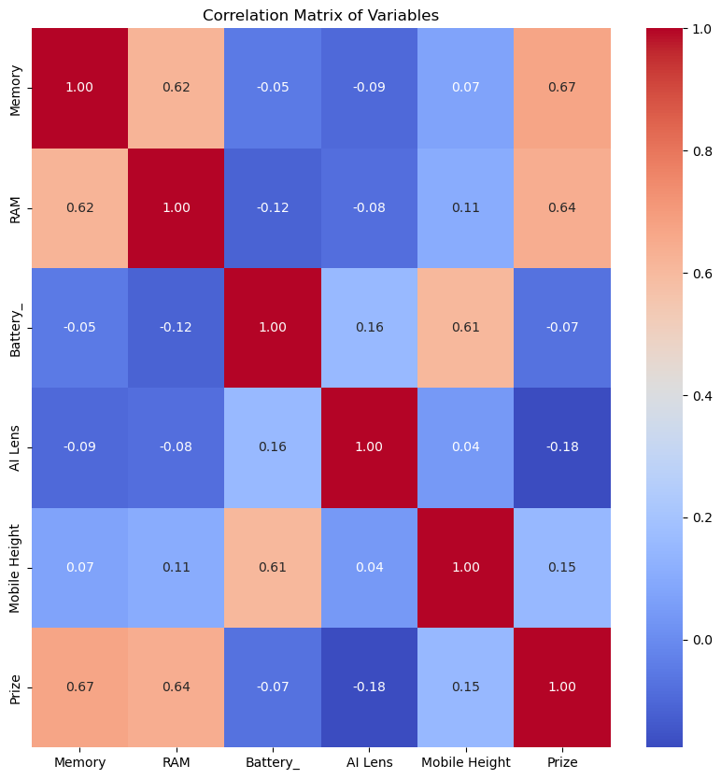
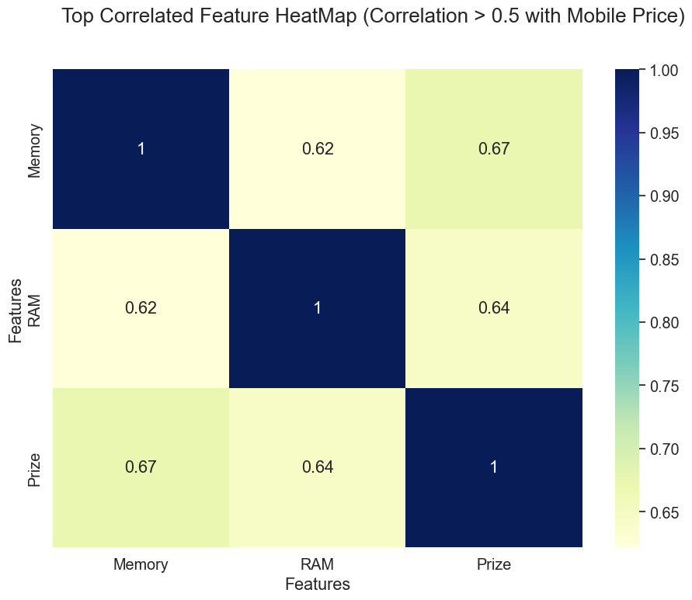
METHODOLOGY
Exploratory Data Analysis (EDA):
a. Multivariate Analysis: : Perform multivariate analysis to understand the correlations and dependencies between various features. Utilize techniques like correlation matrices or scatterplot matrices for a comprehensive view.

Slide 8
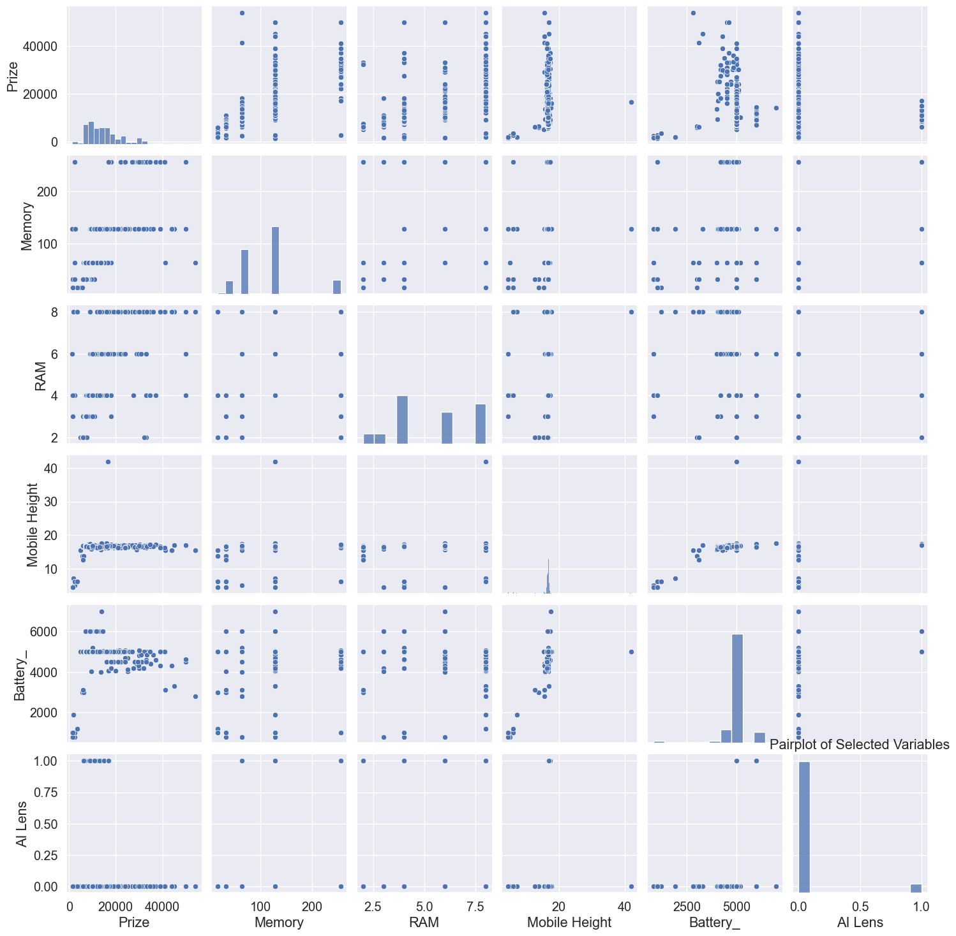
METHODOLOGY
Multivariate Analysis: Pair plots for comprehensive view.

Slide 9
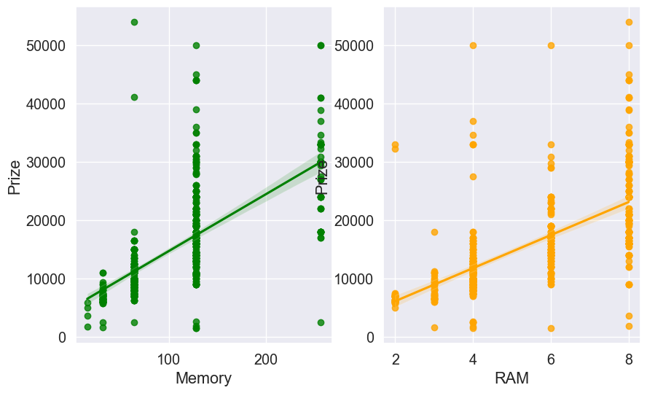
METHODOLOGY
Multivariate analysis: Scatterplots for most correlated variables.

Slide 10
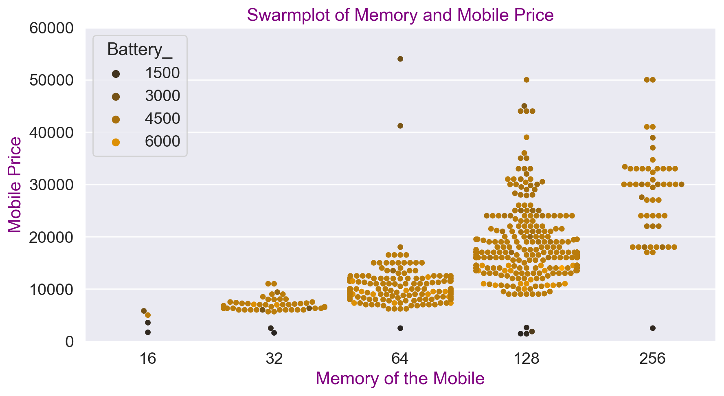
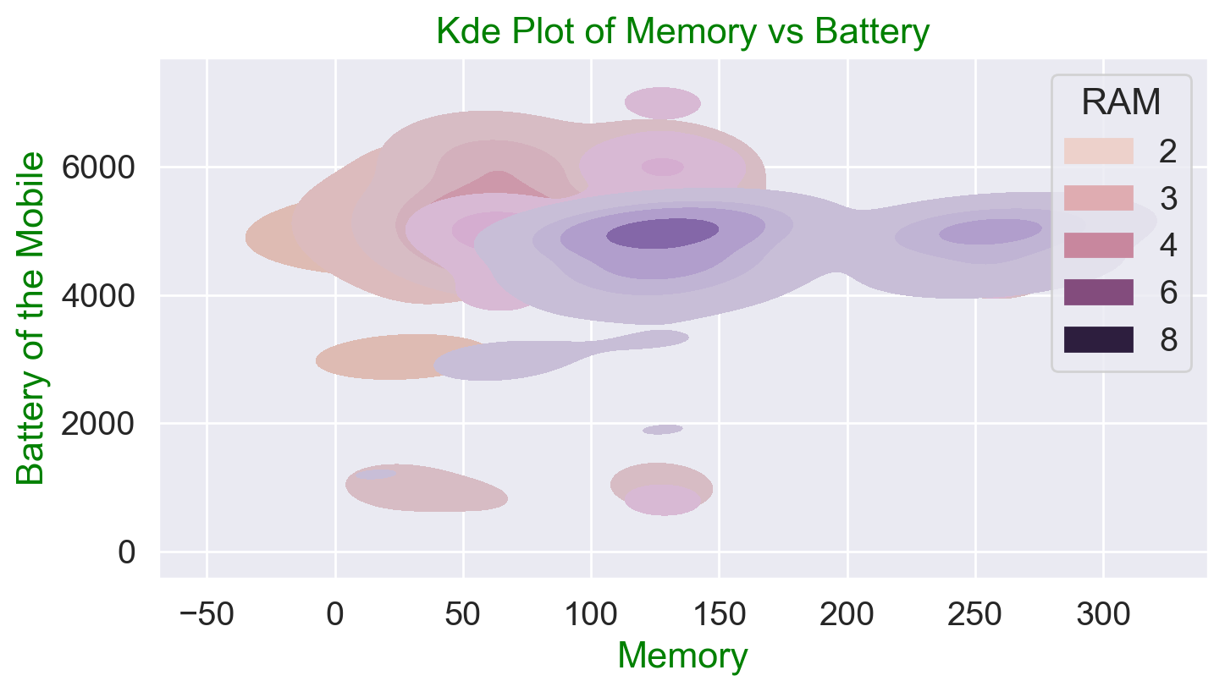
METHODOLOGY
Multivariate analysis: Swarm plots and KDE plots for better understanding.

Slide 11
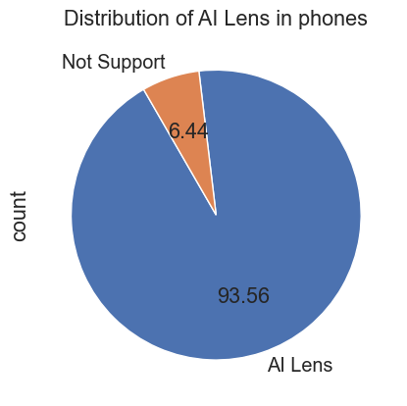
METHODOLOGY
PIE CHART OF DISTRIBUTION OF AI LENS.

Slide 12
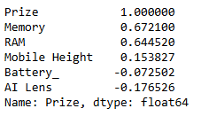
METHODOLOGY
4. Feature Selection:
Techniques: Use statistical tests, correlation matrices, and domain knowledge to select relevant features for model training. The below is the most correlated features to the Mobile Price.
Dimensionality Reduction: Apply techniques like Principal Component Analysis (PCA) or feature importance ranking to reduce complexity and improve model performance.
Conclusion: It shows that pca is not required as the data has only few number of variables.
0

Slide 13
METHODOLOGY
5. Model Selection and Training:
Regression Models: Worked on different types of regression algorithms with the following accuracy scores.
1. Linear Regression: The R2 score of the Linear Regression Model is too less of 0.44.
2. Decision Tree Regressor: The R2 score of the Decision Tree Regression Model is 0.85.
3. Adaboost Regressor: The R2 score of the Adaboost Regression Model is 0.68.
4. XGBoost Regressor: The R2 score of the XGBoost Regression Model is 0.89.
CONCLUSION: Based on the above R2 scores XGBoost Regressor was considered as the best suitable model for the Mobile Price Prediction.

Slide 14
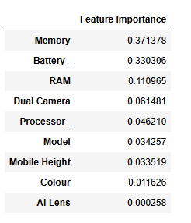
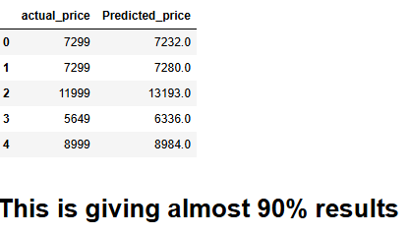
METHODOLOGY
Measuring other Metrics like Mean absolute Error and Root mean squared error through xgboost. The results are as follows:
R2 score using XGBoost Regressor: 0.89.
Mean absolute Error using XGBoost Regressor: 1118.87
Room Mean Squared Error using XGBoost Regressor: 2375.79.
Creating a dataframe with variables and corresponding feature importances. The results are as follows:

Slide 15
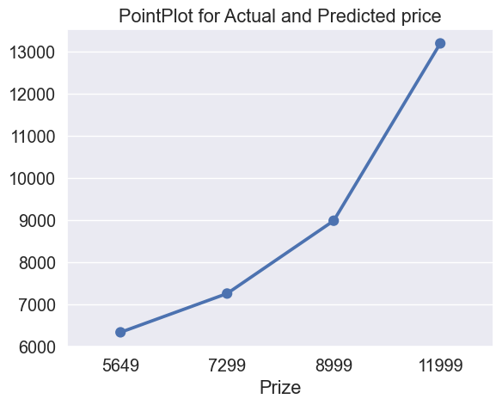
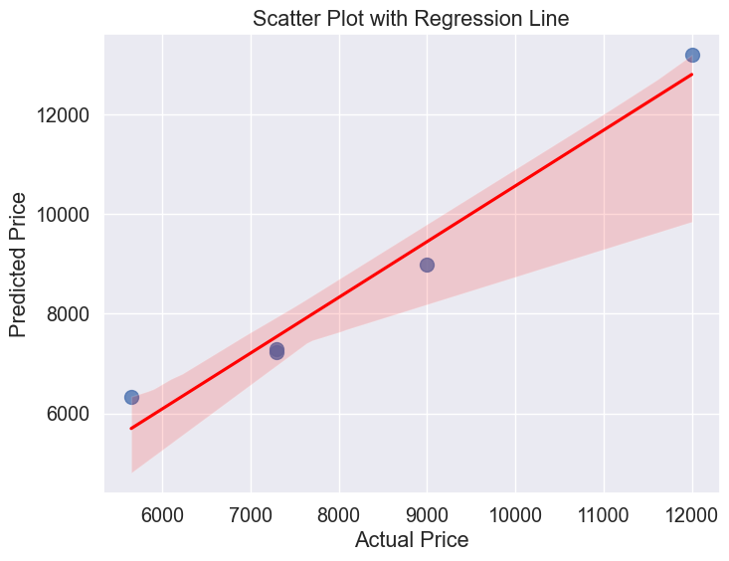
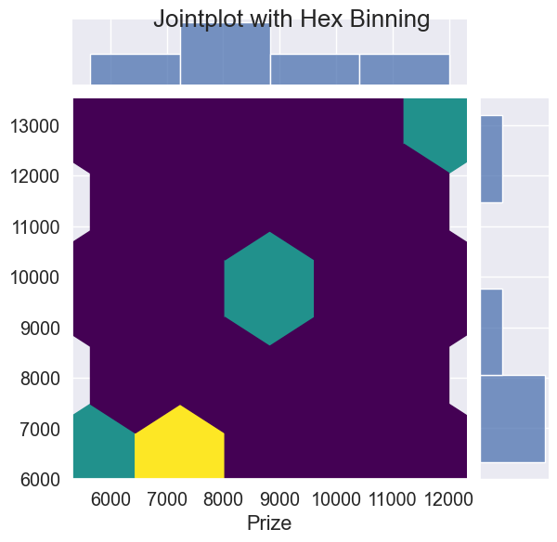
METHODOLOGY
DIFFERENT TYPE OF PLOTS FOR ACTUAL VS PREDICTED VALUES. LIKE POINTPLOT, SCATTER PLOT AND JOINT PLOT WITH HEXBINNING.

Slide 16
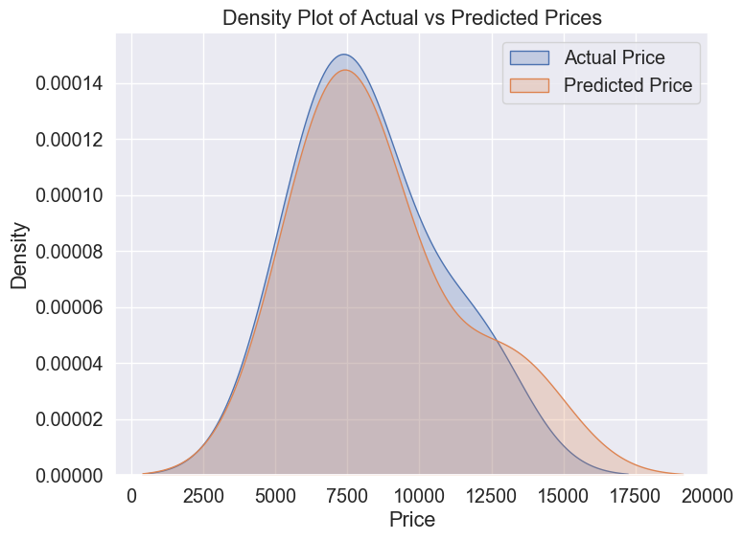
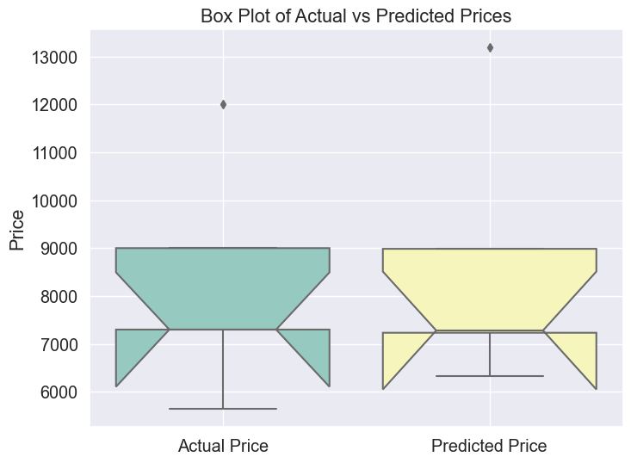
METHODOLOGY
Density plot and box plot for the actual versus predicted prices.

Slide 17
METHODOLOGY
CALCULATING THE MAE, RMSE AND R2 SCORE OF THE ACTUAL AND PREDICTED PRICES
The scores are as follows:
Mean absolute error between actual and predicted prices: 396.4
Root mean squared error of actual and predicted prices: 616.87
R2 score of the actual and predicted prices: 0.91795
CONCLUSION OF THE ABOVE:
Based on these metrics:
The model performs well in predicting mobile phone prices, as indicated by the high R2 score.
2.The MAE and RMSE, while not negligible, are reasonable for predicting prices depending on the price range and context of the mobile phones involved.

Slide 18
FINAL CONCLUSION
Based on the feature importance values provided for mobile price prediction, here’s a conclusion drawn:
MEMORY: Memory capacity (likely referring to internal storage) is the most influential feature for predicting mobile phone prices. Phones with higher storage capacities generally command higher prices.
BATTERY: Battery capacity or battery life is the second most important feature. This suggests that phones with longer battery life or larger battery capacities tend to have higher prices.
RAM: Random Access Memory (RAM) plays a moderately important role in price prediction. Higher RAM allows for smoother multitasking and better performance.
DUAL CAMERA: Having a dual camera setup is also a notable factor but less influential compared to memory, battery, and RAM.
PROCESSOR: The type or performance of the processor is moderately influential.
MODEL: The specific model or brand of the phone has some impact on price prediction.
MOBILE HEIGHT: Mobile phone dimensions (likely referring to physical size or design aspects) contribute marginally to price prediction.
COLOR: The color of the phone has minimal impact on pricing compared to other technical specifications. However, certain colors or finishes may appeal more to specific consumer demographics, influencing pricing to a small extent.
AI LENS: The presence of AI lens features has negligible impact on price prediction. This suggests that while AI technology is a trending feature, its direct influence on pricing may be minimal compared to other hardware specifications.

Slide 19

NAME: S. Sujana Kumari
THANK YOU

